Slide 1

Digital Egypt Pioneers Initiative
Microsoft Machine Learning Track

Slide 2
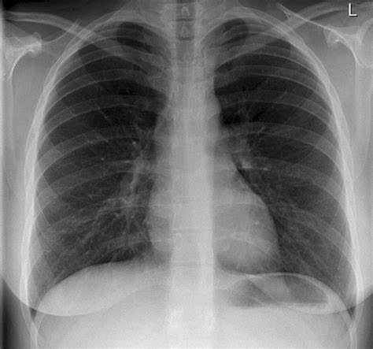
Under supervision Eng : Abdelhamid
Chest X-Ray
Team :
Mahmud Salah Abdelbar ( Leader)
Muhammed Essam Ragab
Ahmed Adel Ibrahim
Muhammed Farahat Muhammed
Muhammed Nasser Ahmed

Slide 3
Introduction
The goal of this notebook is to use Convolutional Neural Networks on Chest X-Ray images to determine which samples are from patients with Pneumonia. In this dataset (version 3), there is one folder representing the train set and another one for the test set. The train folder is later split in the notebook into train/validation sets. We use three different approaches for image classification:
1) A simple CNN.
2) Transfer Learning. using a pretrained model with frozen layers as the base for feature extraction.
3) Fine Tuning, unfreezing the last layers of the pretrained model.

Slide 4
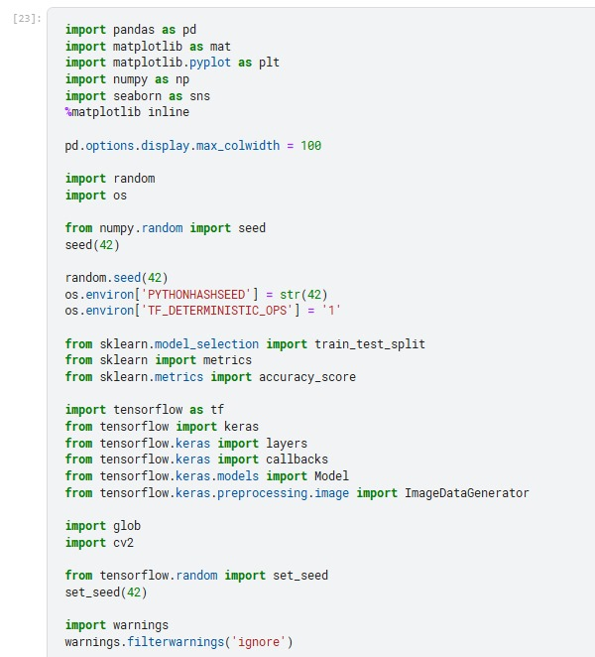
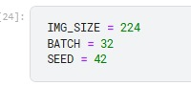
Importing Packages and Dataset

Slide 5
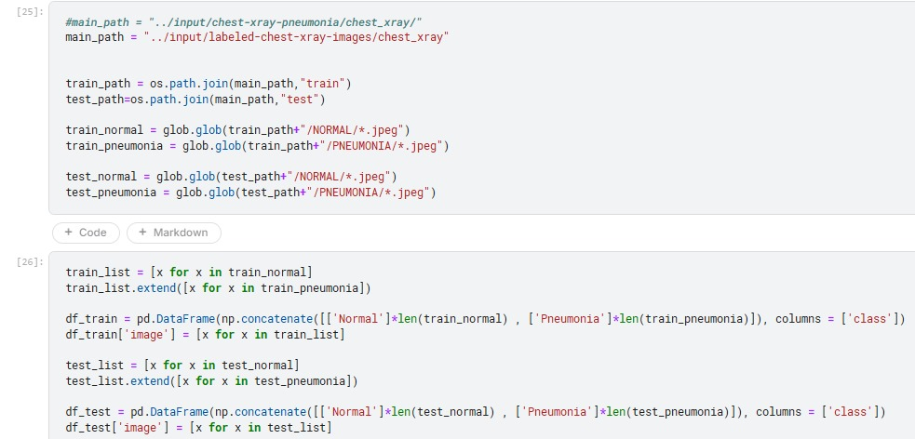
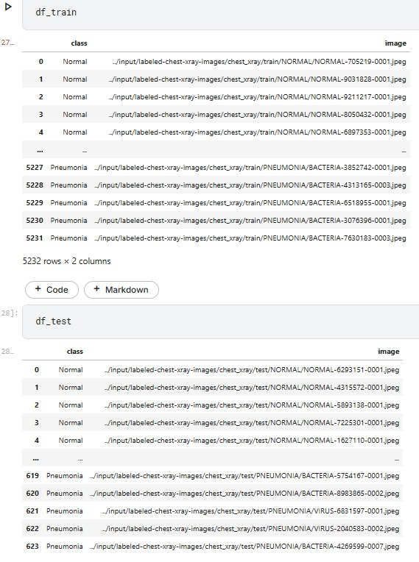
Importing Packages and Dataset

Slide 6
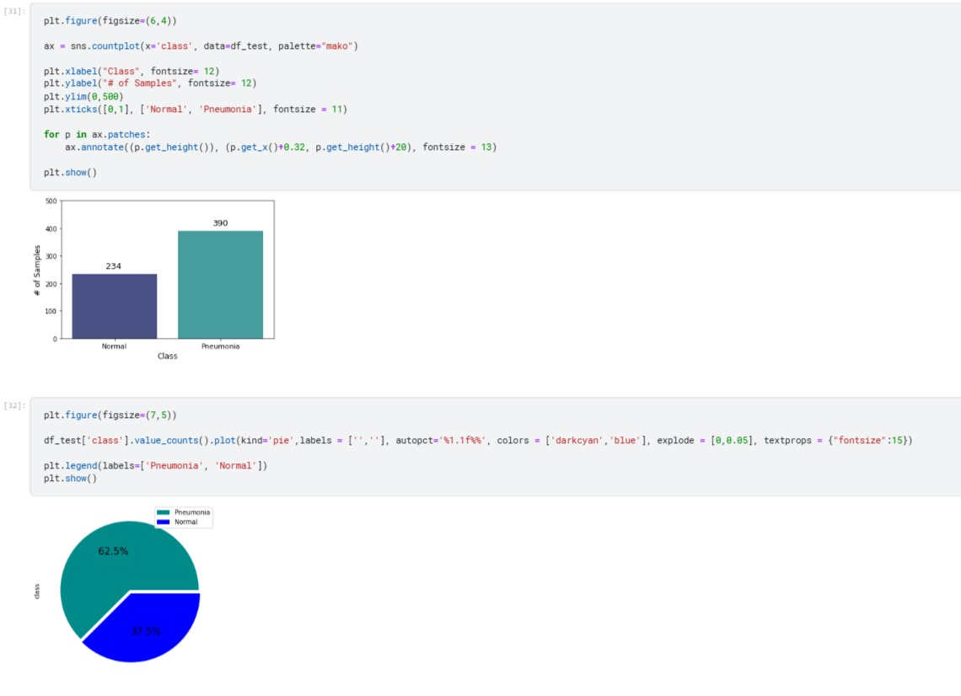
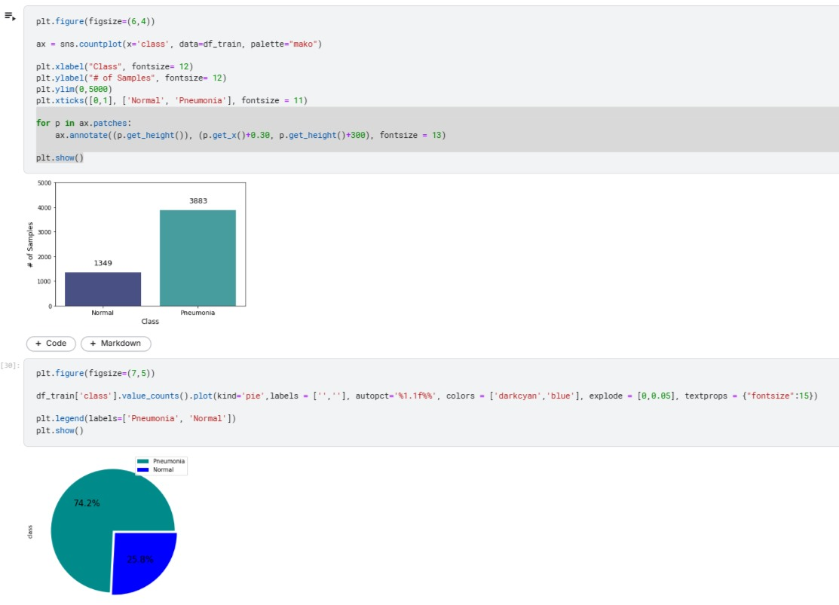




Exploring the Data

Slide 7
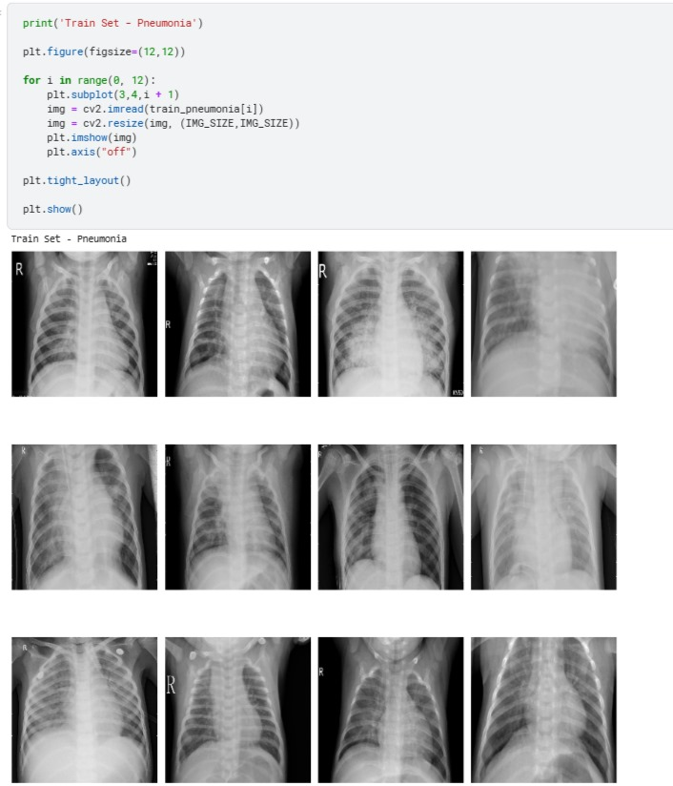
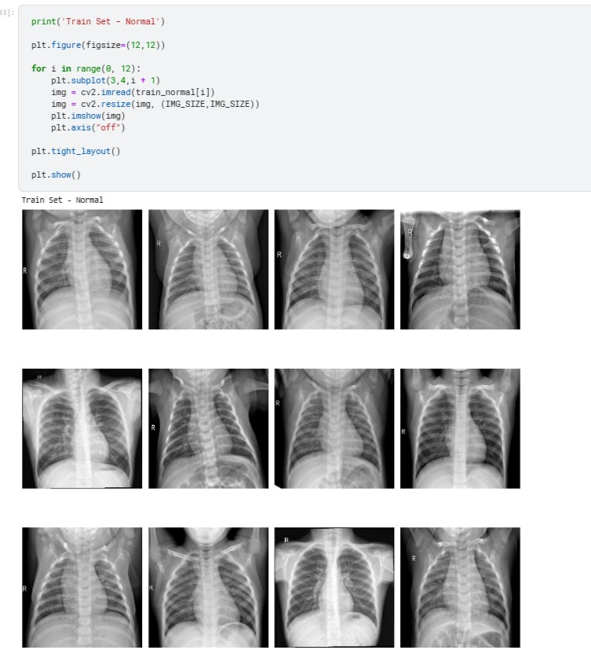
Exploring the Data

Slide 8
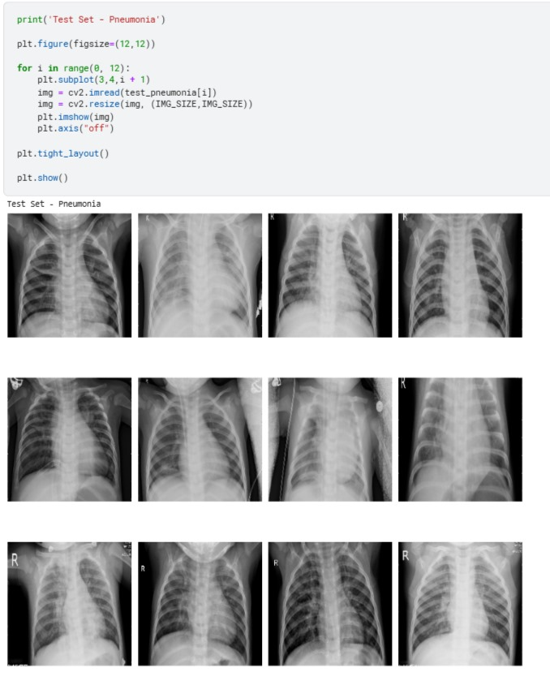
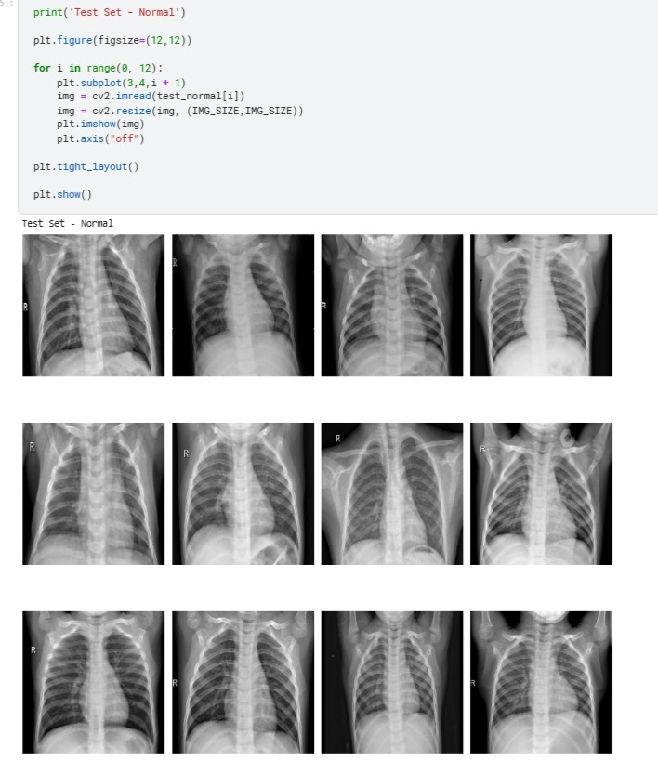
Exploring the Data

Slide 9
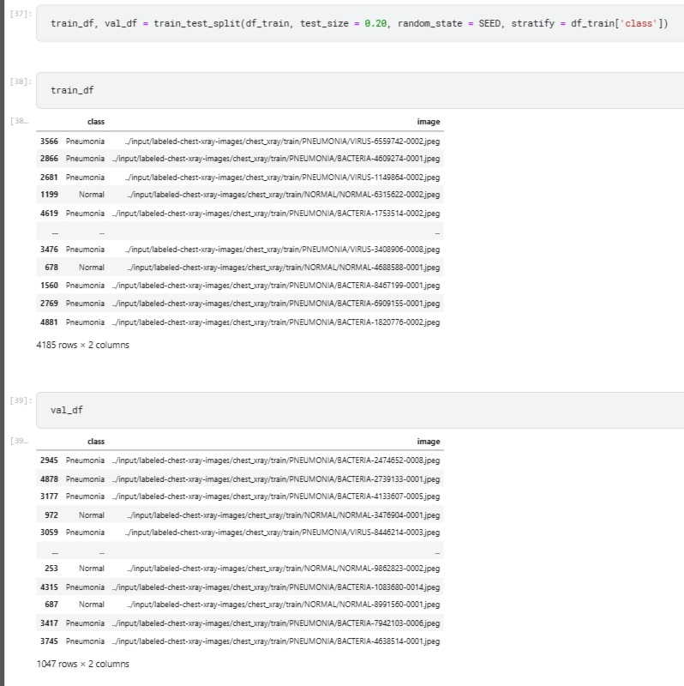
Preparing the Data
Preparing the Data

Slide 10
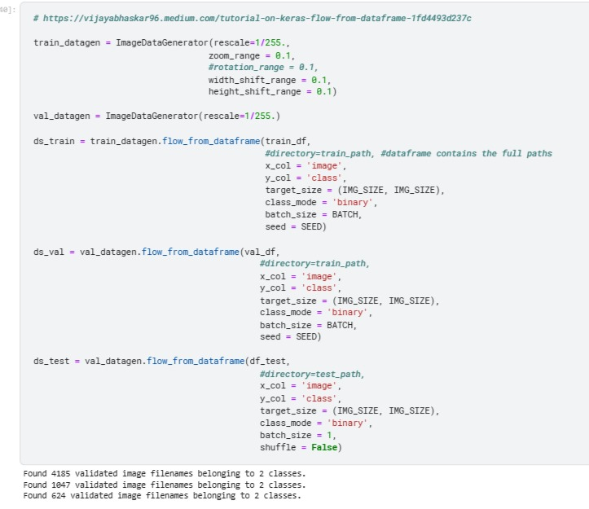
Preparing the Data

Slide 11
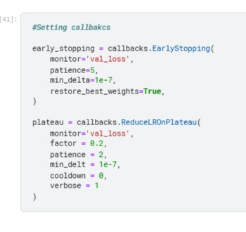
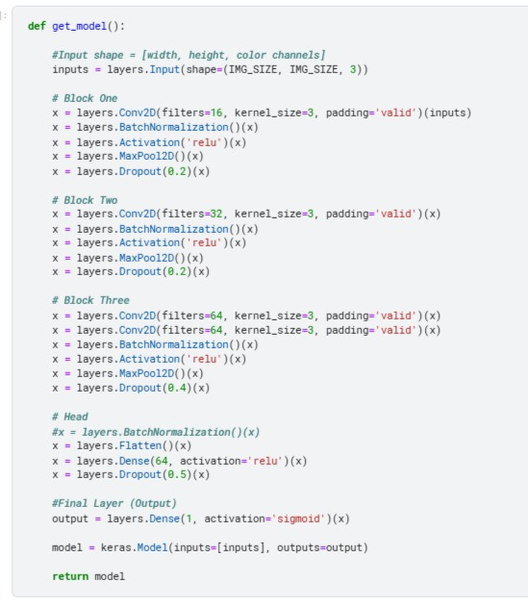
Custom CNN

Slide 12
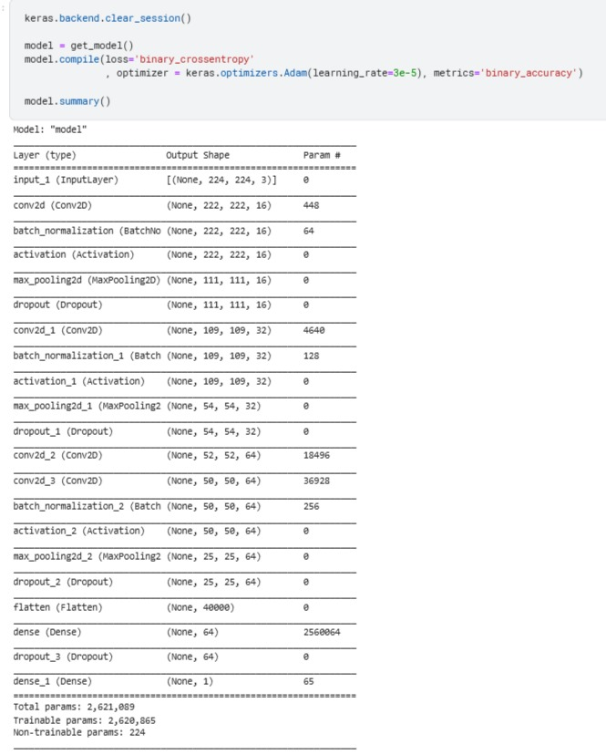
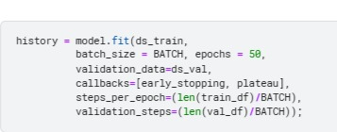
Custom CNN

Slide 13
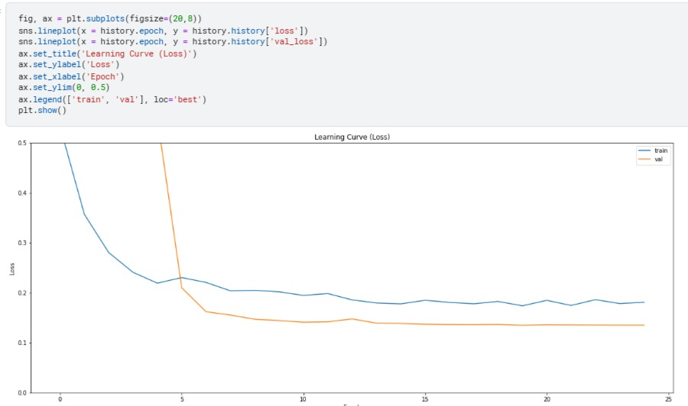
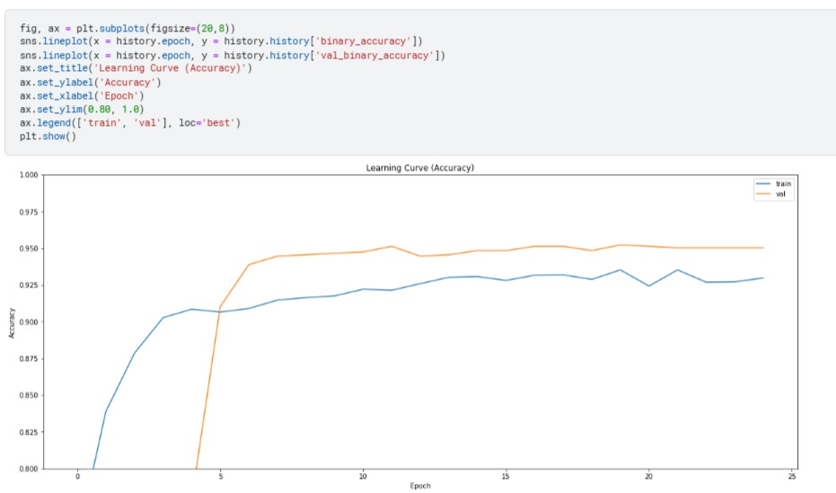
Custom CNN

Slide 14
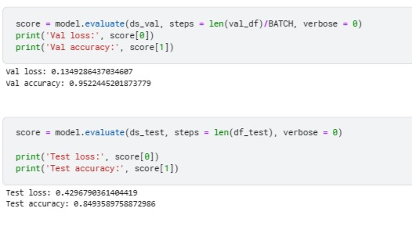
Custom CNN

Slide 15
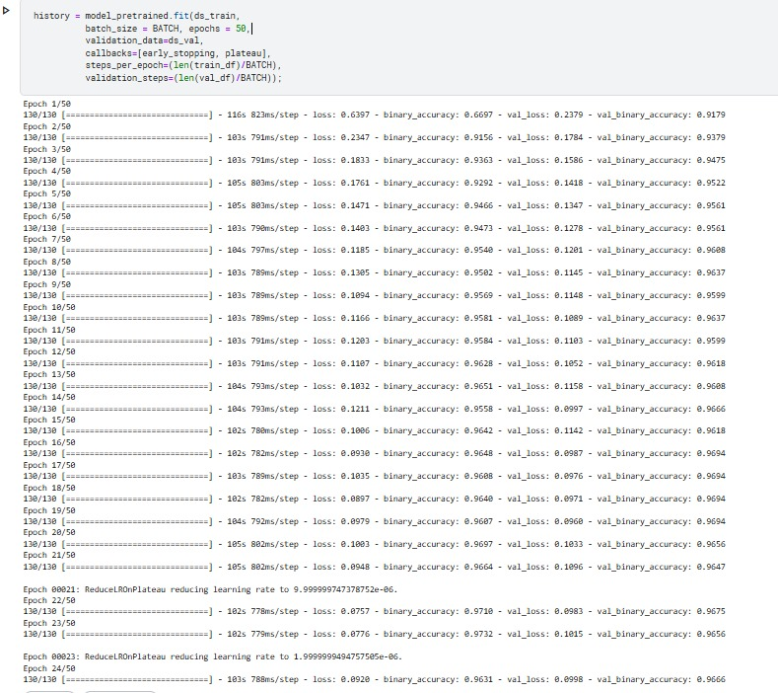
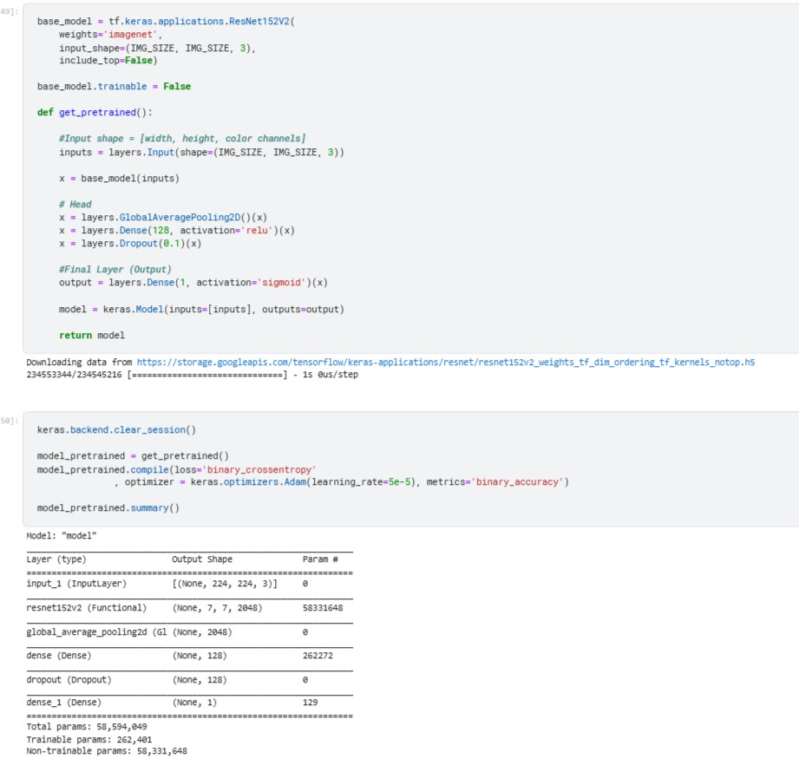
Transfer Learning

Slide 16
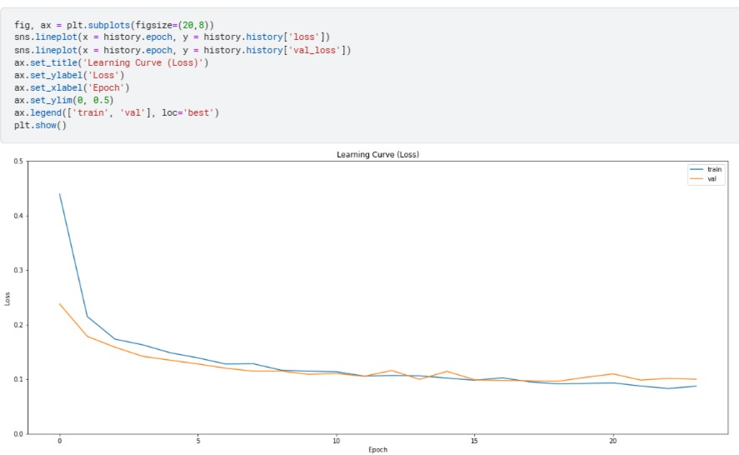
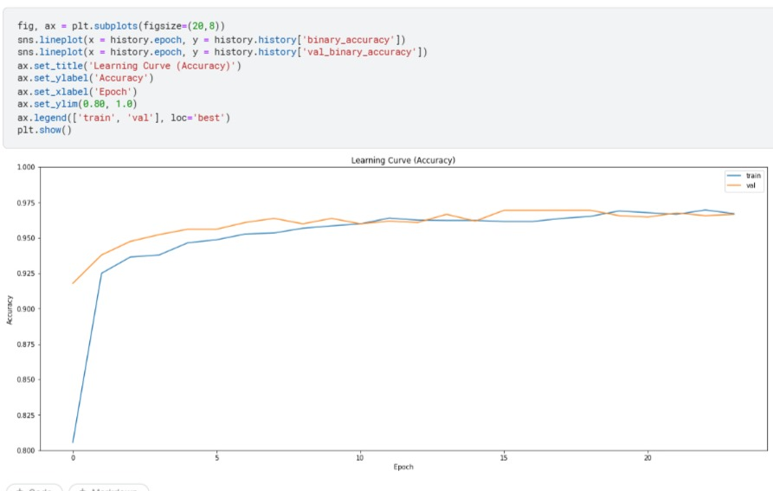
Transfer Learning

Slide 17
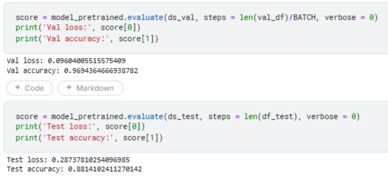
Transfer Learning

Slide 18
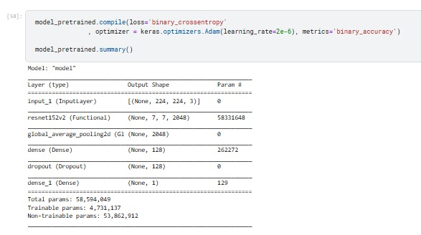
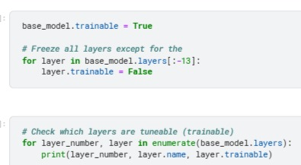
Fine Tuning

Slide 19
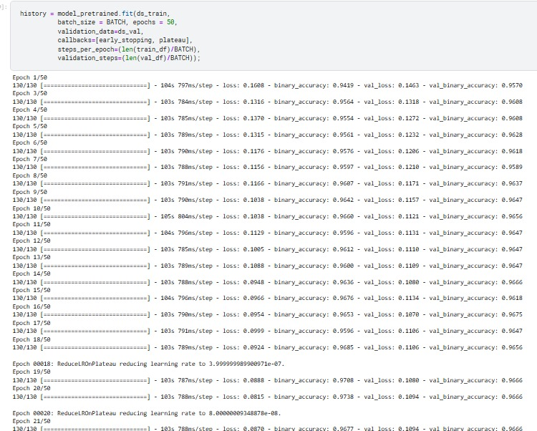
Fine Tuning

Slide 20
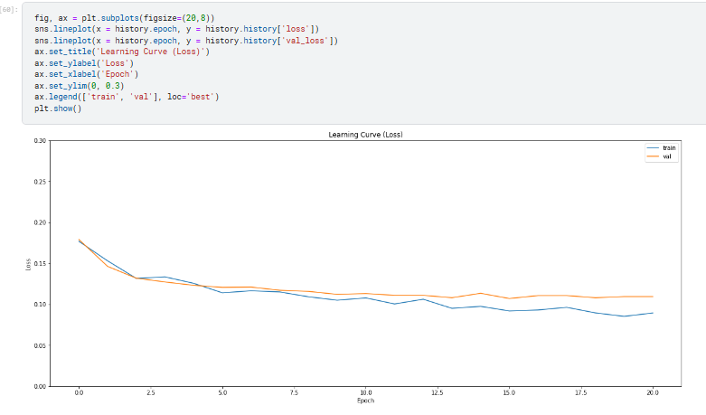
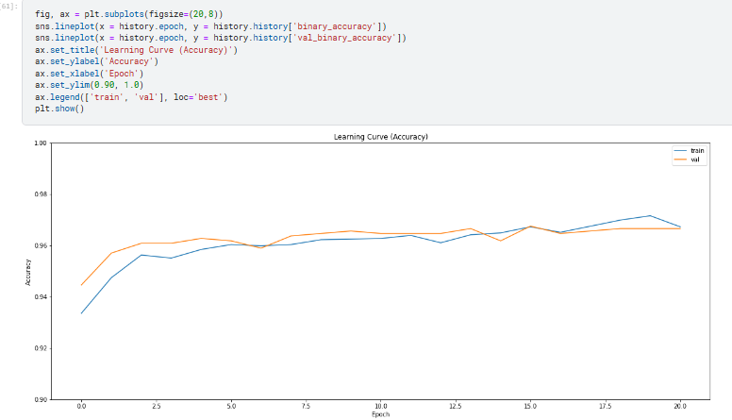
Fine Tuning

Slide 21
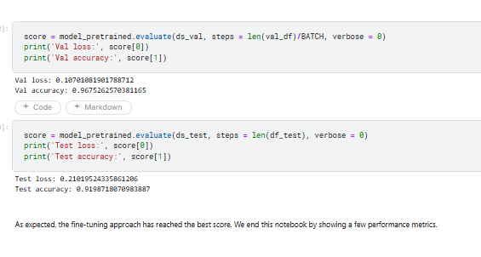
Fine Tuning

Slide 22
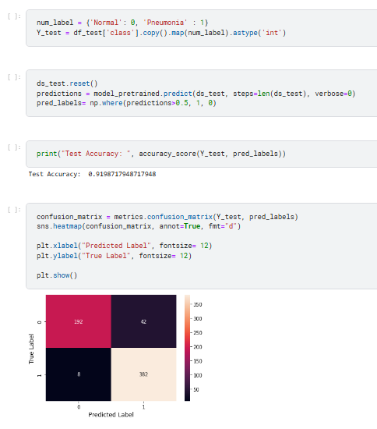
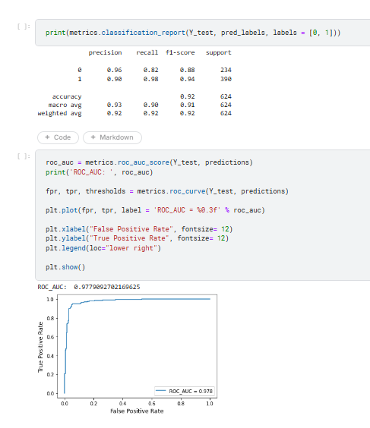
Performance Metrics

Slide 23
References
https://vijayabhaskar96.medium.com/tutorial-on-keras-flow-from-dataframe-1fd4493d237c
https://github.com/mrdbourke/tensorflow-deep-learning/blob/main/03_convolutional_neural_networks_in_tensorflow.ipynb
https://www.tensorflow.org/guide/keras/transfer_learning
https://www.tensorflow.org/api_docs/python/tf/keras/preprocessing/image/ImageDataGenerator
https://keras.io/api/applications/
https://keras.io/api/applications/resnet/#resnet152v2-function

